Slide 1
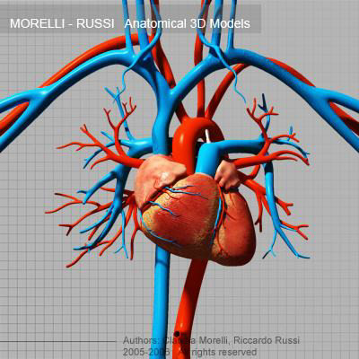
Components of our Circulatory System

Slide 2
What we will be looking at:
Why do multi-cellular organisms need and internal transport system?
List the functions of our circulatory system
What is plasma and what is in it?
Compare erythrocytes, leukocytes and thrombocytes in terms of:
Structure, function, where are they made, numbers in blood,
lifespan
Describe the formation of a blood clot
Compare arteries, capillaries and veins in terms of: structure, valves, direction of blood flow, what they carry and relative blood pressure
Blood types and blood transfusions
What is agglutination and why is it dangerous?
What blood type and why are the universal donors and recipients?

Slide 3
Why do multicellular organisms need an internal transport system?
Cells on the inside don’t have direct contact with external cells and therefore need to be supplied with oxygen and nutrients and to get rid of carbon dioxide and wastes

Slide 4
List functions of the circulatory system
1) transport oxygen/carbon dioxide
2) transport nutrients/wastes
3) regulate temperature
4) transport hormones
5) transport our immune system

Slide 5
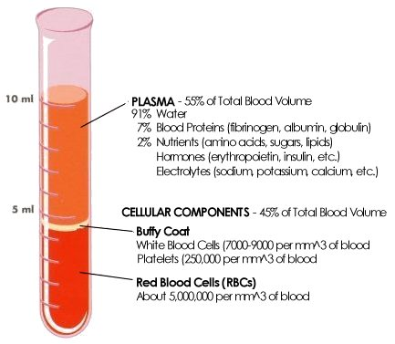
What is plasma and what is in it?

Slide 6
Blood Plasma
The liquid portion of the blood
Makes up about 55% of total blood volume
Mostly water 90% and the other 10% is dissolved materials like- protein, glucose, vitamins, gas and wastes

Slide 7
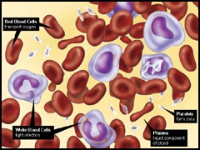
What makes up the rest of the blood volume?
The other 45 % of your blood is made of: White blood cells(Leukocytes), Red blood cells(Erythrocytes) and Platlets (thrombocytes).

Slide 8
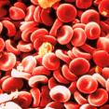
Red Blood Cells (Erythrocytes)

Slide 9

Red Blood cells inside a blood vessel

Slide 10
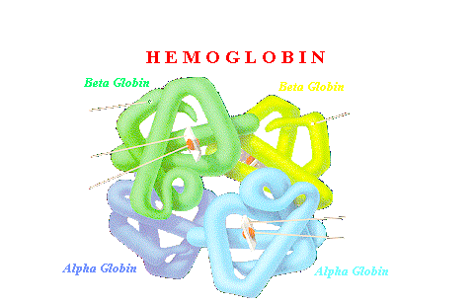
Hemoglobin

Slide 11
Red Blood Cells
Donut shaped (greater surface area)
They don’t have a nucleus at maturity to allow more room inside the cell to carry oxygen - hemoglobin (about 280 million per red blood cell)
They are made in your bone marrow
There is about 4.5 to 5.5 million/ml of blood
They last about 120 days

Slide 12
When the red blood cells do eventually break down the hemoglobin molecules are released.
The iron from the hemoglobin is recycled by the bone marrow and the Heme pigment is removed by the body through our feces (giving our feces its color)

Slide 13
Anemia
Normally caused by an iron deficiency due to poor iron absorption by the body or lack of iron in the diet or excessive bleeding
This lack of iron causes less hemoglobin to form in red blood cells
Less oxygen is transported to the mitochondria for respiration
Lack of energy results

Slide 14
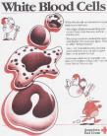
White Blood Cells (Leukocytes)

Slide 15
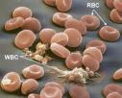

Slide 16
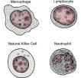
Types of white blood cells

Slide 17


Slide 18
White blood cells
These are your defense army against foreign invaders (IMMUNE SYSTEM) to fight against infection
Five different types with slightly different jobs that can be identified by their nucleus shape after staining
Made in the bone marrow
About 5000 to 9000 /ml
Some last hours and others a lifetime

Slide 19

Leukemia

Slide 20
Leukemia- what is it?
Leukemia is cancer that originates in the bone marrow, the soft, spongy inner portion of certain bones, and in which the malignant cells are white blood cells (leukocytes). Acute myelogenous leukemia is a malignancy that arises in either granulocytes or monocytes which are white blood cells that battle infectious agents throughout the body.

Slide 21
Symptoms of Leukemia
The patient's bone marrow makes too many blast cells (immature white blood cells). Normal blast cells turn into a type of white blood cell called granulocytes, but the leukemia blast cells do not. At the same time, the marrow cannot grow enough normal red blood cells, white blood cells, and platelets.

Slide 22
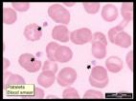
Platlets (Thrombocytes)

Slide 23
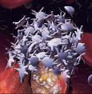

Slide 24
Platelets
Irregular shaped cells
Contain NO nucleus at maturity
Help to clot blood
Made in bone marrow
About 250 000/ml
Last about 10 days

Slide 25
Blood clotting
As platelets circulate through the blood stream they may encounter a damaged blood vessel causing the platelets to rupture
This releases a chemical which sets off a chemical chain reaction ultimately forming a web made of fibrinogen to clot the broken blood vessel

Slide 26


Slide 27
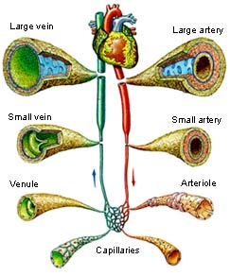
Arteries, Capillaries and Veins

Slide 28

Arteries/capillaries/veins

Slide 29
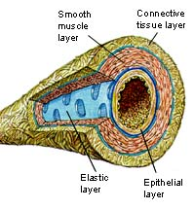

Slide 30
Arteries
Very thick
Outer Coat-smooth muscle-elastic layer-lining
There are NO valves in them
They bring blood Away from the heart
They carry oxygen (ONE exception in the pulmonary artery)
High blood pressure

Slide 31
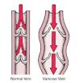
Veins

Slide 32
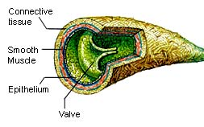
Veins

Slide 33
Similar structure to arteries but thinner
They DO contain one-way valves
They bring blood towards the heart
They carry Carbon Dioxide (with the exception of the pulmonary vein)
The blood is under low pressure in them

Slide 34
Varicose Veins
Due to the low blood pressure there are one way valves to prevent the backflow of blood
Sometimes the blood pools at these valves causing the vein to get larger=varicose veins

Slide 35
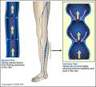

Slide 36



Slide 37
Treatment for Varicose Veins
Vein stripping
Injections
New veins are able to reroute and grow around the removed veins

Slide 38

Capillaries

Slide 39
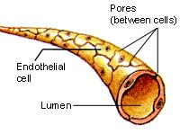
Capillaries

Slide 40
Capillaries
Very thin walled to allow for diffusion
Come in contact with cells
Acts as a bridge between arteries and veins
Contain NO valves
Carry both oxygenated and deoxygenated blood

Slide 41
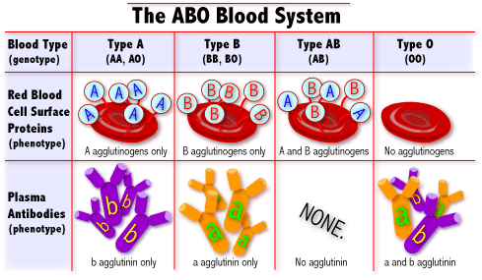
Blood Types and Transfusions

Slide 42
Agglutination
When different blood types are mixed antibodies may latch onto the introduced blood type and cause clumping/clotting (agglutination) of the blood
This can go on to cause death!

Slide 43
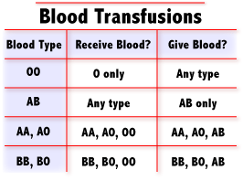

Slide 44
AB+ blood type is considered the UNIVERSAL RECIPIENT because they would have NO antibodies against any blood types and therefore could receive any blood type
O- blood type is considered the UNIVERSAL DONOR because there are no antigens on the donated blood for any antibodies to recognize or bind onto and therefore all blood types could receive O-

